Slide 1

HIKING 101
A Hiking with Shawn Presentation

Slide 2
Free Trail Guides, Blogs, Maps, and More!
Visit: www.HikingWithShawn.com

Slide 3
Follow me on Social Media!
Daily videos: www.YouTube.com/hikingwithshawn
Facebook: www.Facebook.com/hikingwithshawn
Instagram: www.Instagram.com/hikingwithshawn
Twitter: www.Twitter.com/hikingwithshawn
TikTok: www.TikTok.com/@hikingwithshawn

Slide 4
Subscribe to my FREE Monthly Newsletter!
Free exclusive content that you won’t find anywhere else
Events and public group hikes
Special offers and more.
Subscribe at: www.HikingWithShawn.com/newsletter

Slide 5
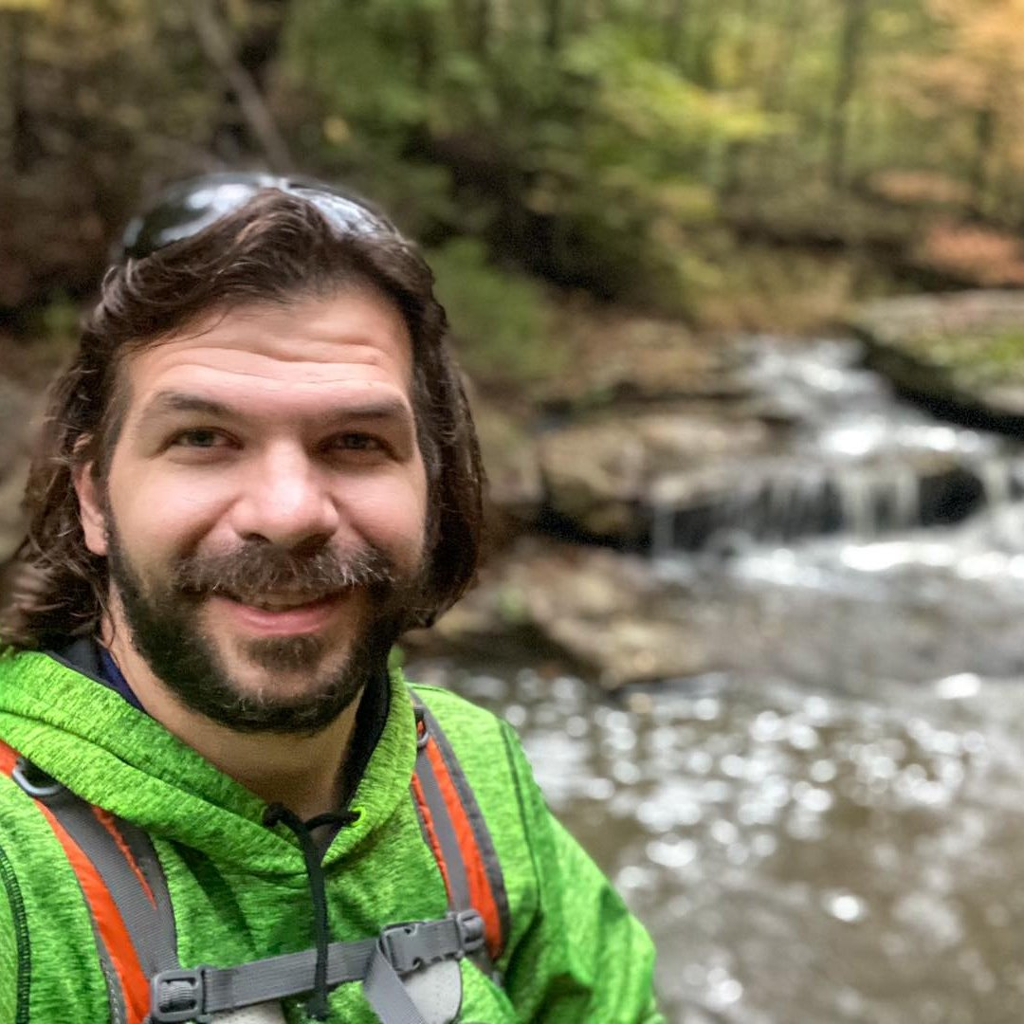
Who Am I?
I’m Shawn Gossman, the founder of Hiking with Shawn.
I started Hiking with Shawn because of my passion for hiking and biking. I wanted to share all these awesome gems of Southern Illinois with EVERYONE!
I mainly make videos and social media content for tourism purposes.
I also have an online store.
I do paid guided hikes in the Shawnee and state park.
I also do paid itinerary planning services for hiking and enjoying the area.

Slide 6
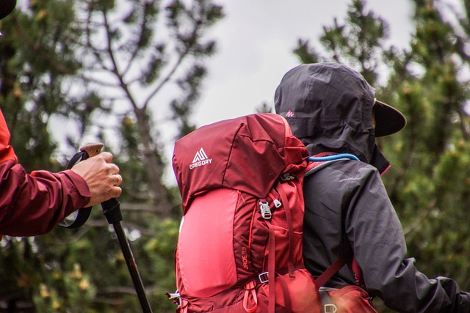
Hiking 101: Gear Basics

Slide 7
What do I wear hiking?
DOs
DON’Ts
Wear hiking-specific clothing on rugged hikes
Wear fitness clothing on shorter easier hikes
Layer up on colder hikers (wool)
Wear study hiking boots or hiking shoes
Wear sunscreen
Wear bug spray
Wear cotton (it doesn’t breath)
Wear crocs or flipflops
Wear High heels
Wear Suits of armor
Wear Tuxedos

Slide 8
Gear to pack in your hiking backpack!
First aid kit
Plenty of water
Plenty of snacks
Emergency Poncho (doubles as a shelter)
Water filter
Fire starting kit
Flashlight with extra batteries
Paper maps
Compass
Trekking poles
Ice cleats for boots
Waterproof socks
Extra layers
Bug spray
Sunscreen
TP (for using the “Facili-trees”.)
Knife
Charging cord/brick for phone

Slide 9

PRO TIP!
Spray your boots, backpack, and non-synthetic hiking clothes with PERMETHRIN to help prevent ticks! DO NOT spray on your skin. Keep away from pets and children.

Slide 10
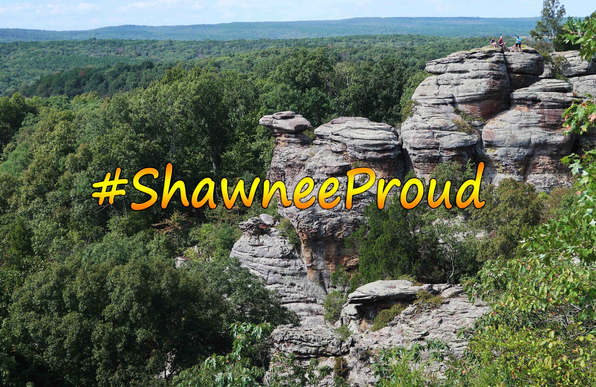
MUST DO HIKES IN THE SHAWNEE NATIONAL FOREST AND STATE PARKS!

Slide 11
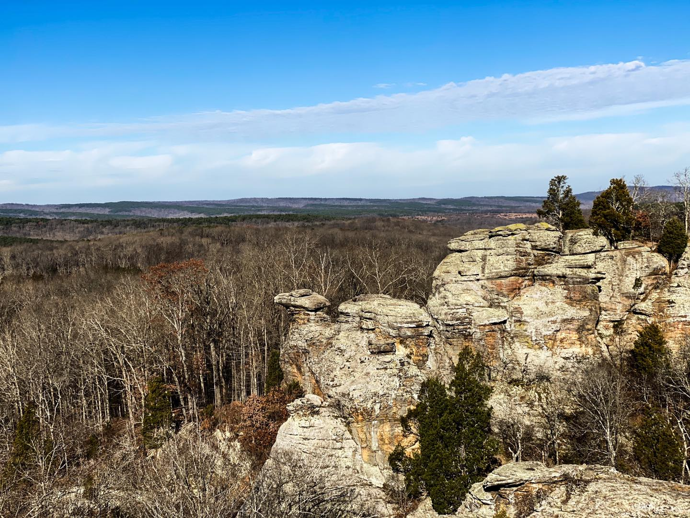
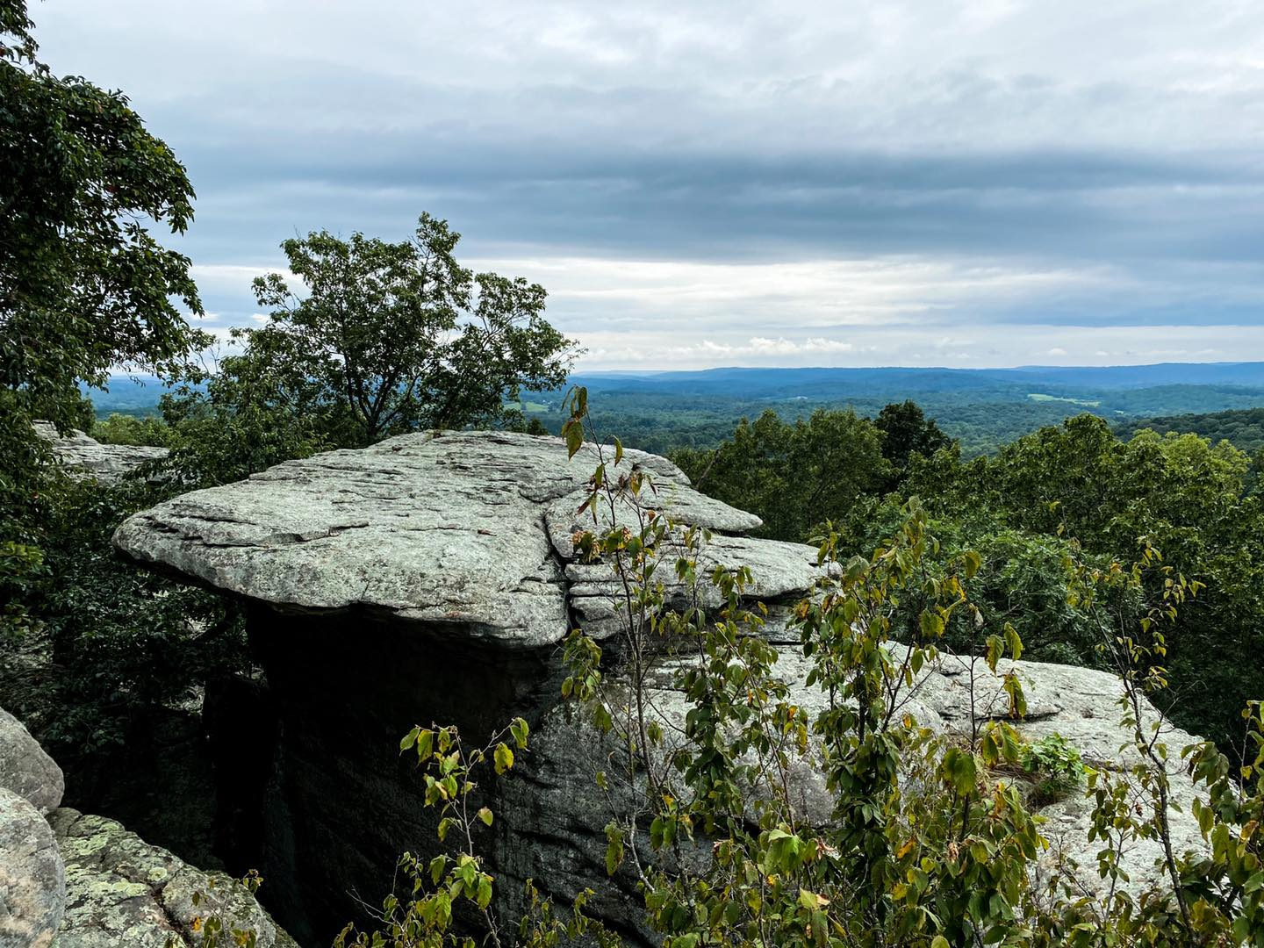
GARDEN OF THE GODS OBSERVATION TRAIL AND INDIAN POINT.

Slide 12
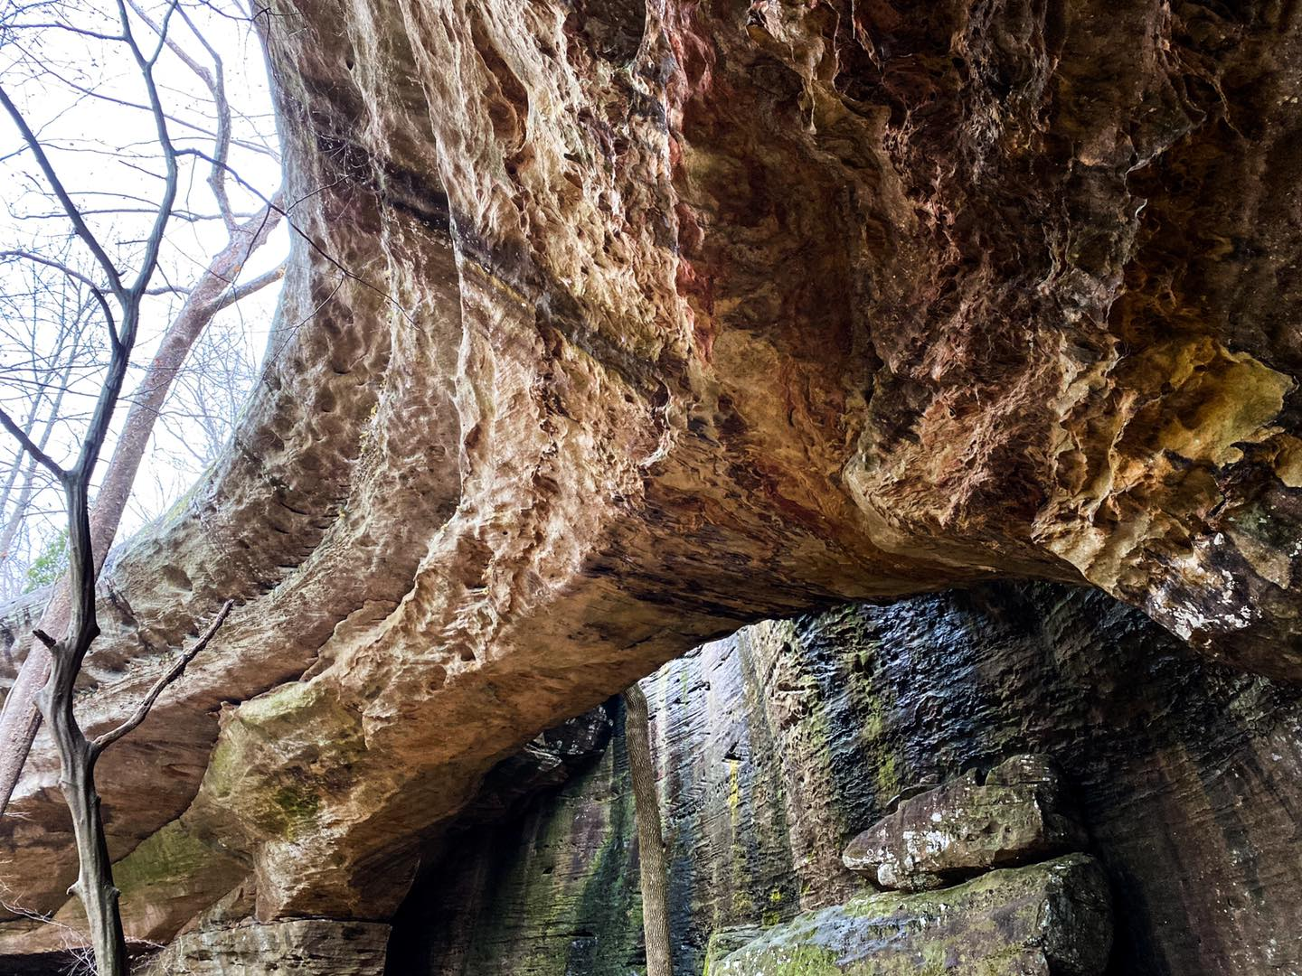
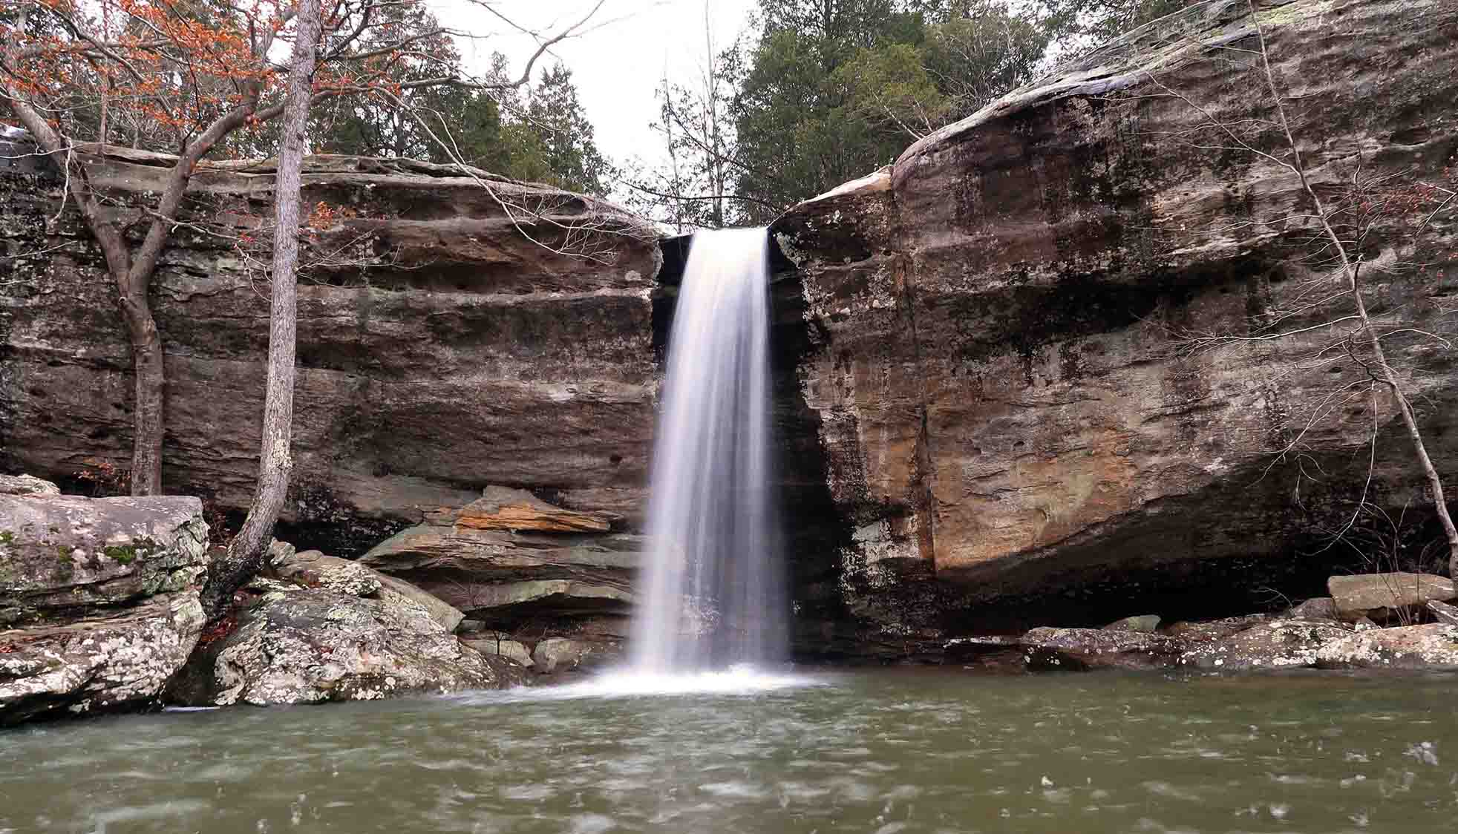
BELL SMITH SPRINGS AND JACKSON FALLS

Slide 13
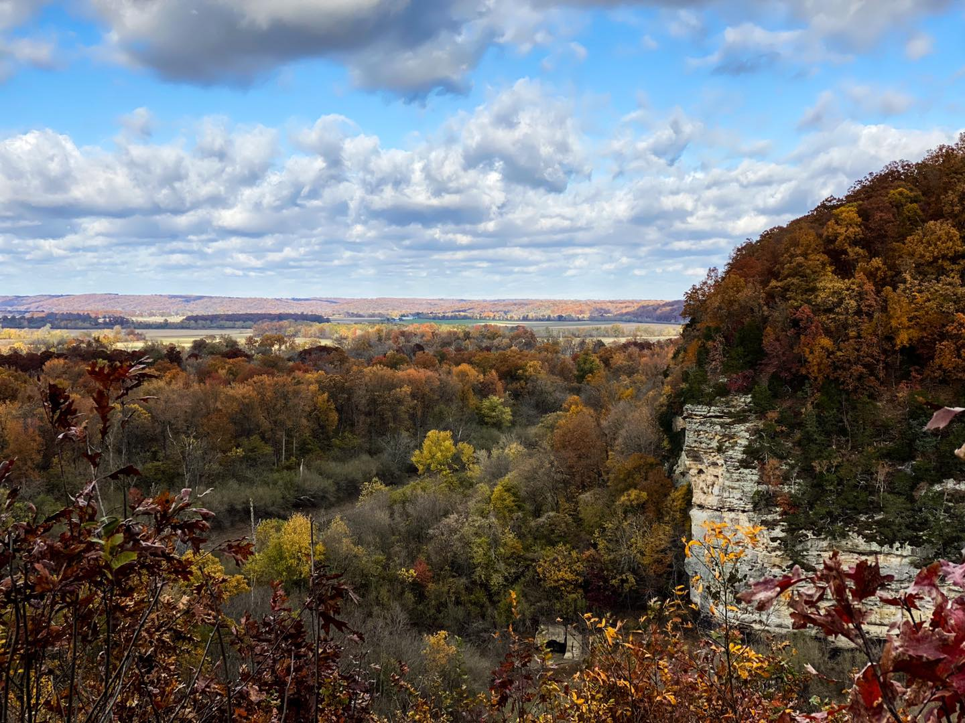
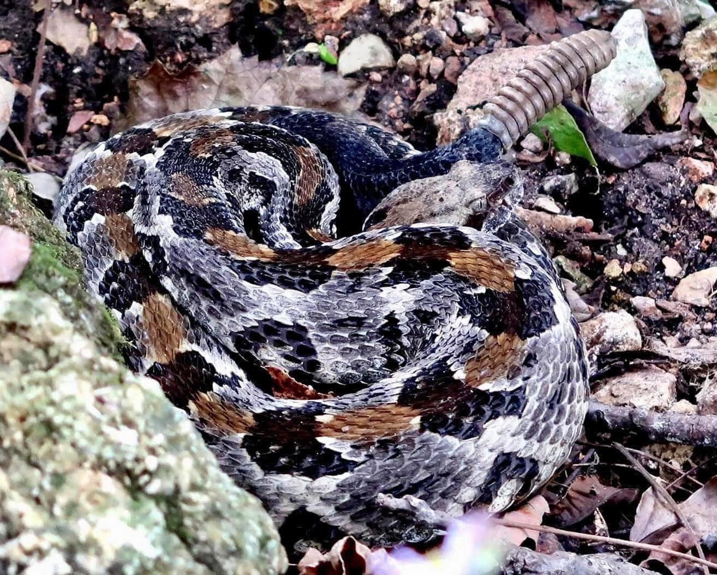
LITTLE GRAND CANYON AND SNAKE ROAD

Slide 14
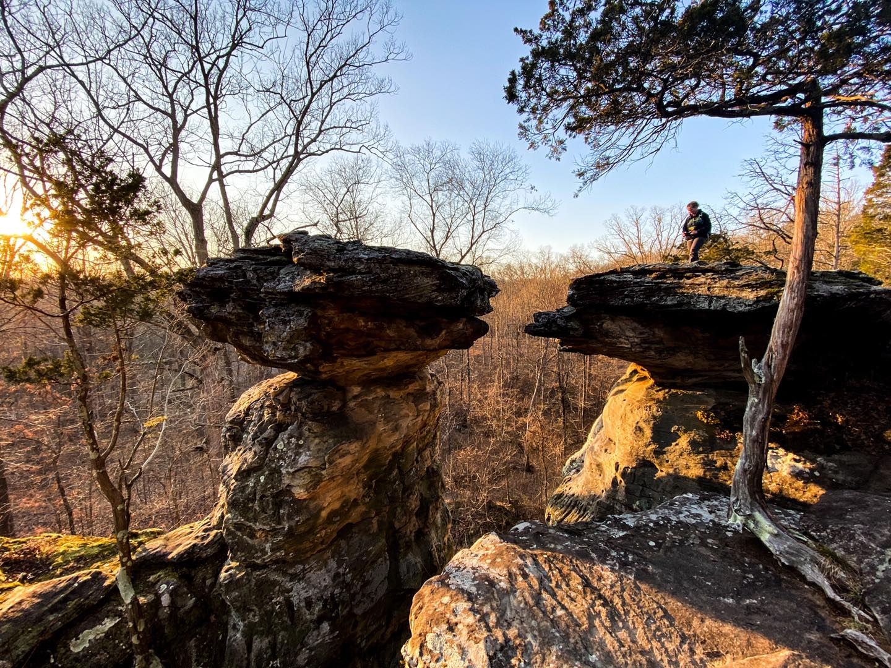
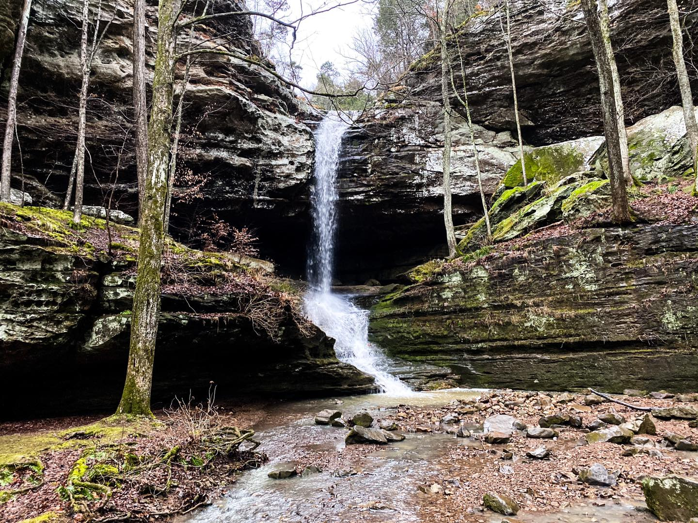
GIANT CITY STATE PARK AND FERNE CLYFFE STATE PARK

Slide 15
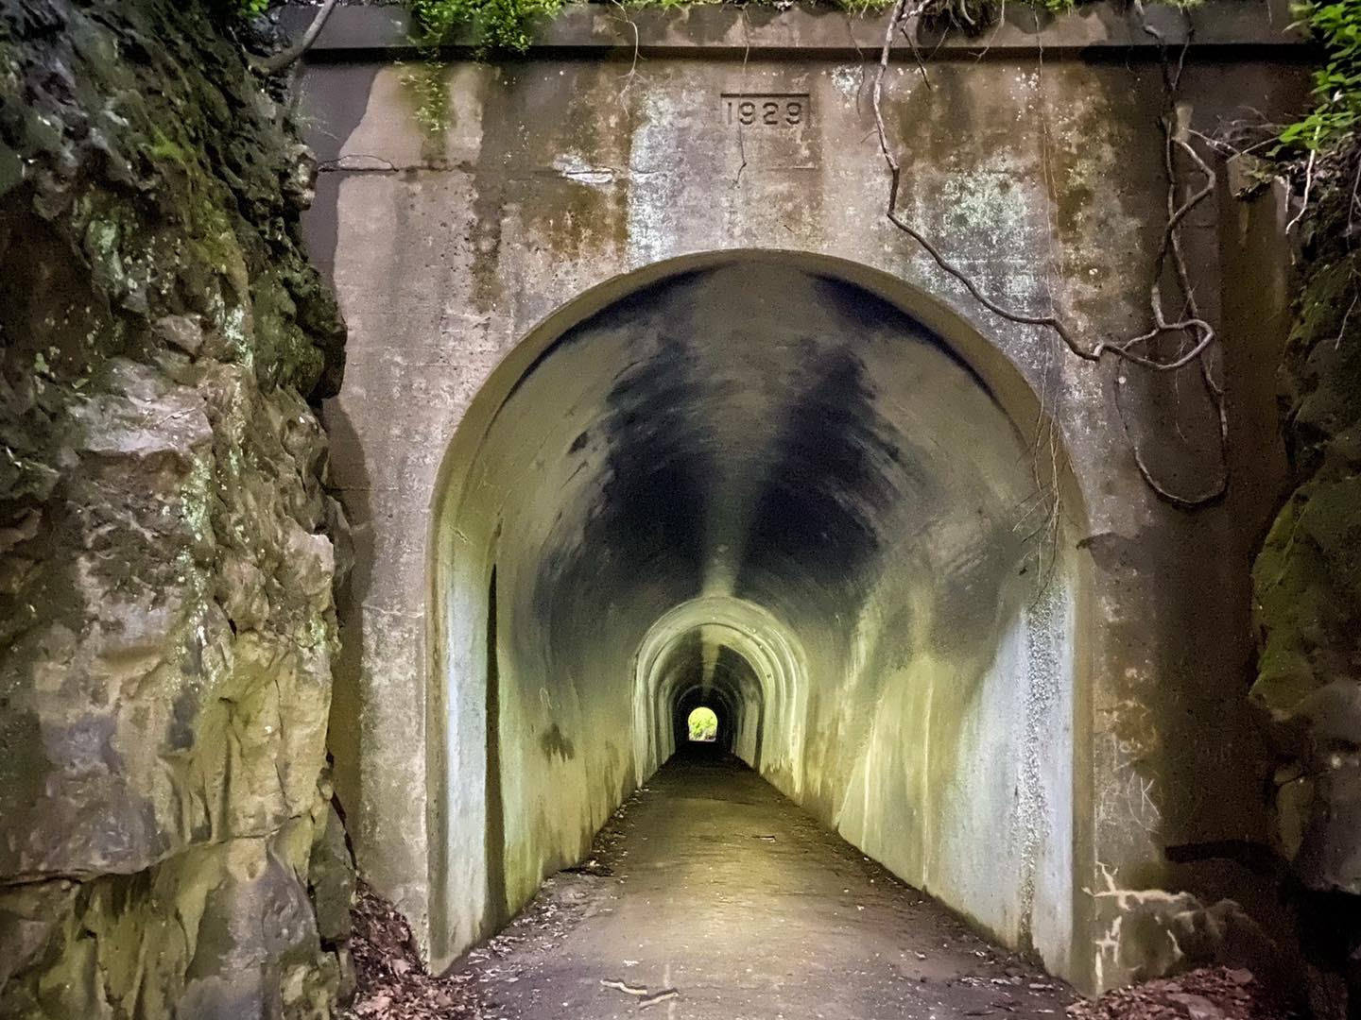
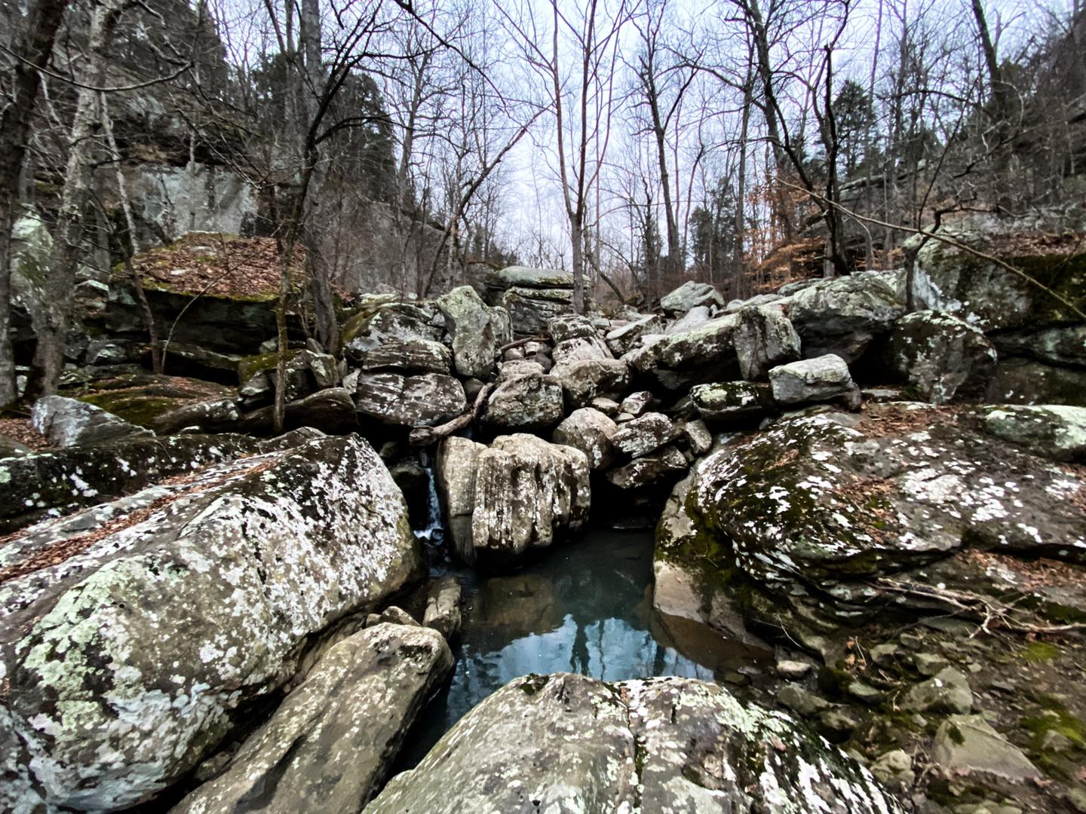
TUNNEL HILL STATE TRAIL AND DIXON SPRINGS STATE PARK

Slide 16
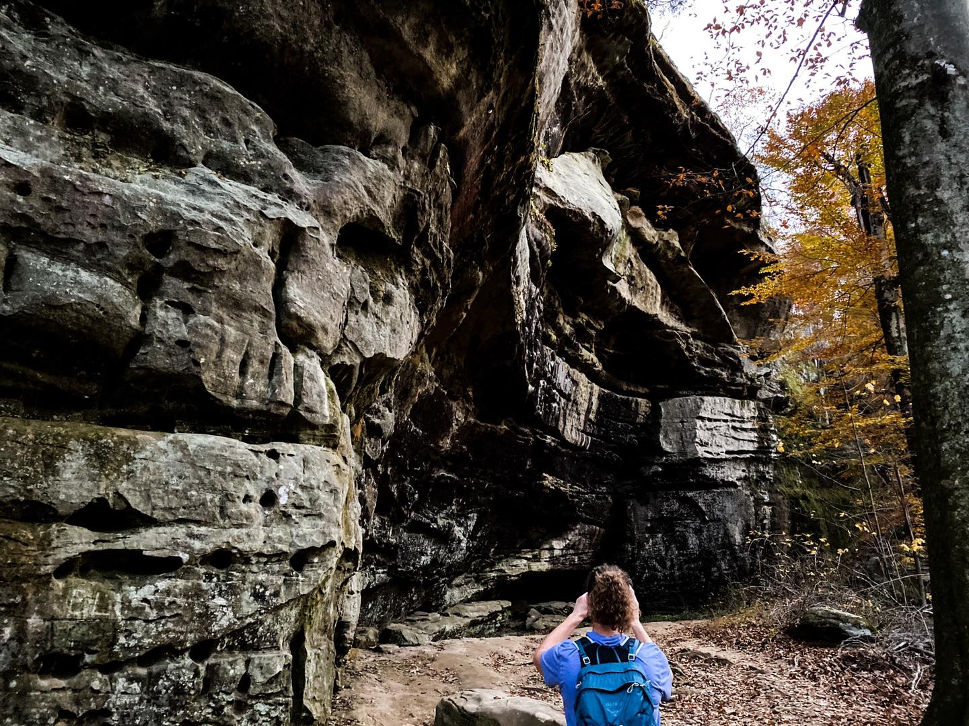
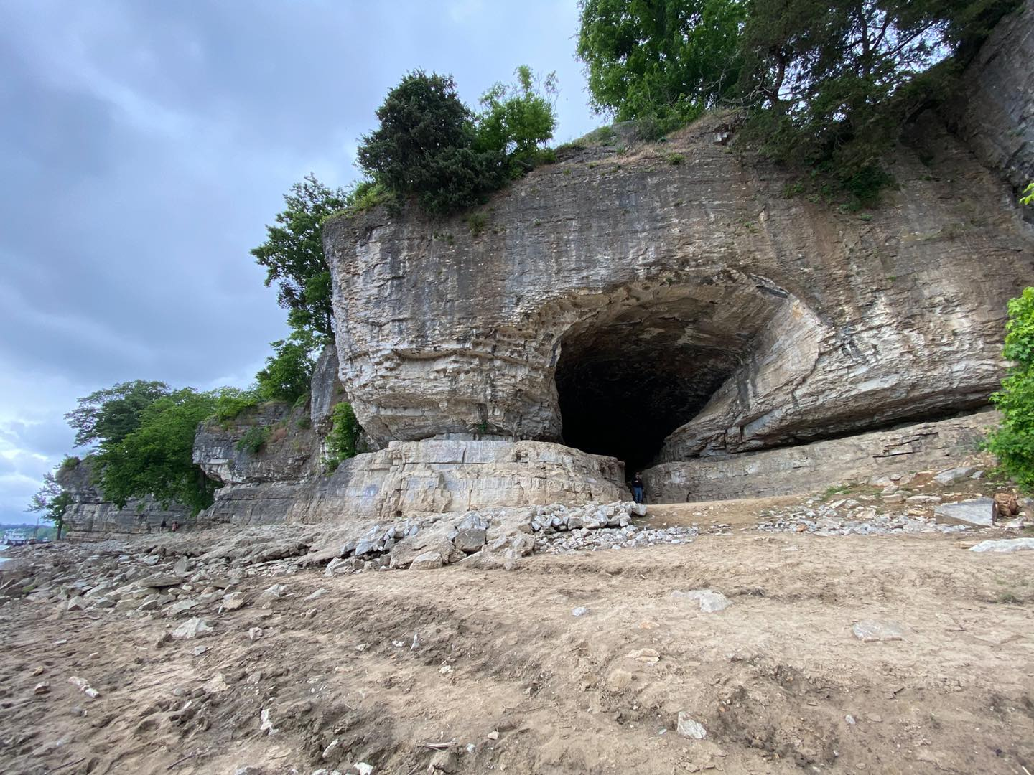
RIM ROCK AND CAVE-IN-ROCK STATE PARK

Slide 17
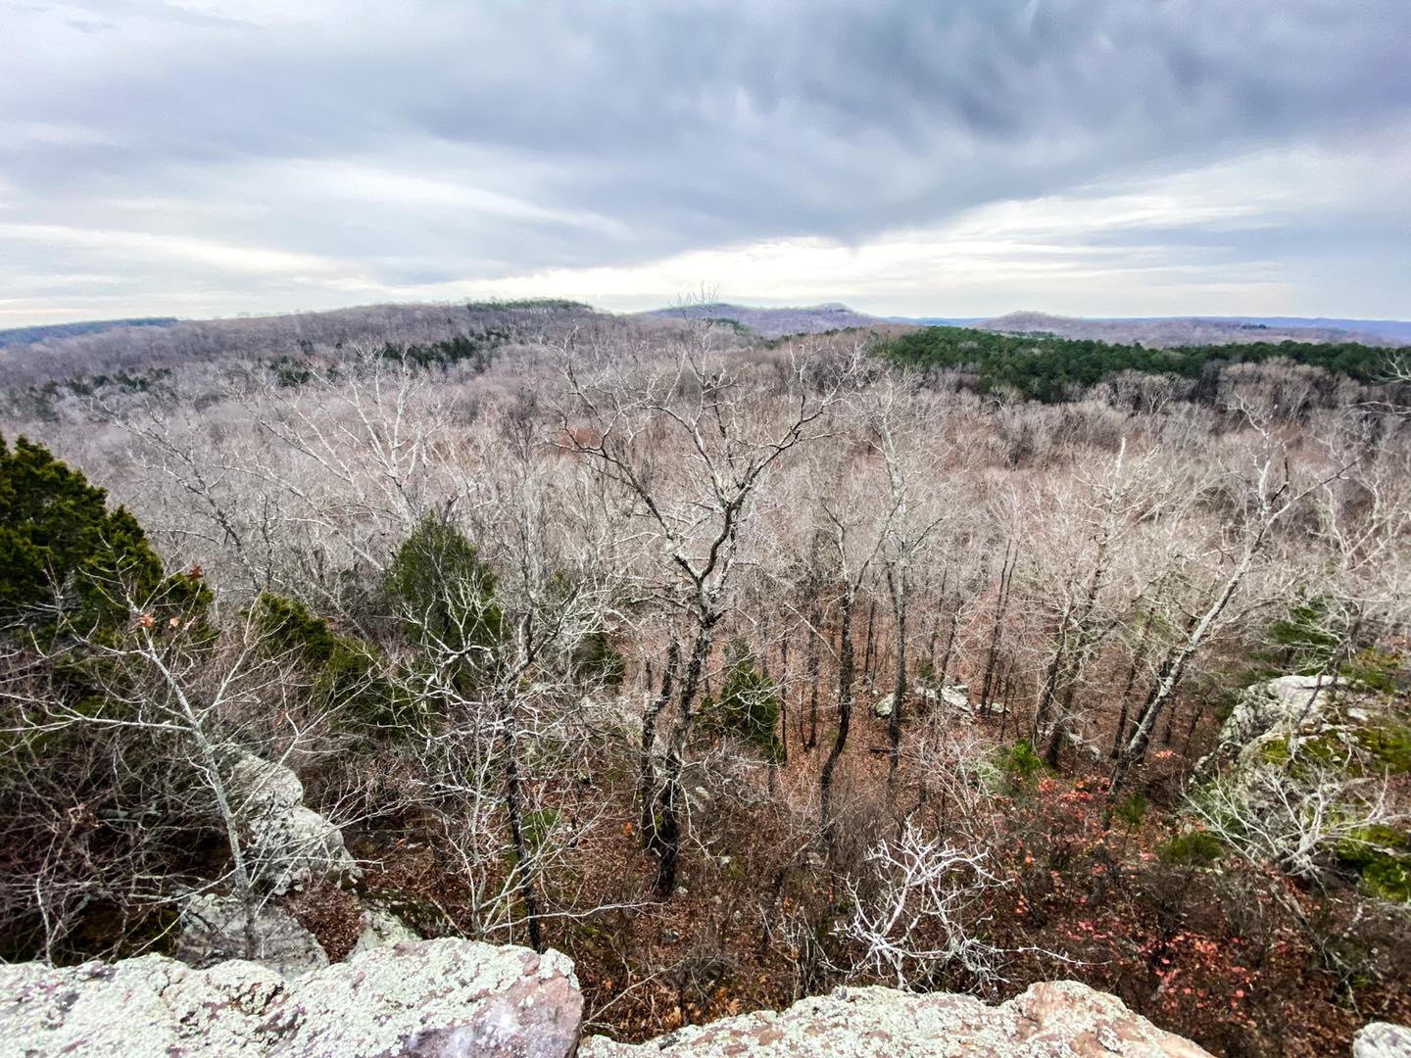
TRAILS NOT SO KNOWN IN THE SHAWNEE NATIONAL FOREST!

Slide 18
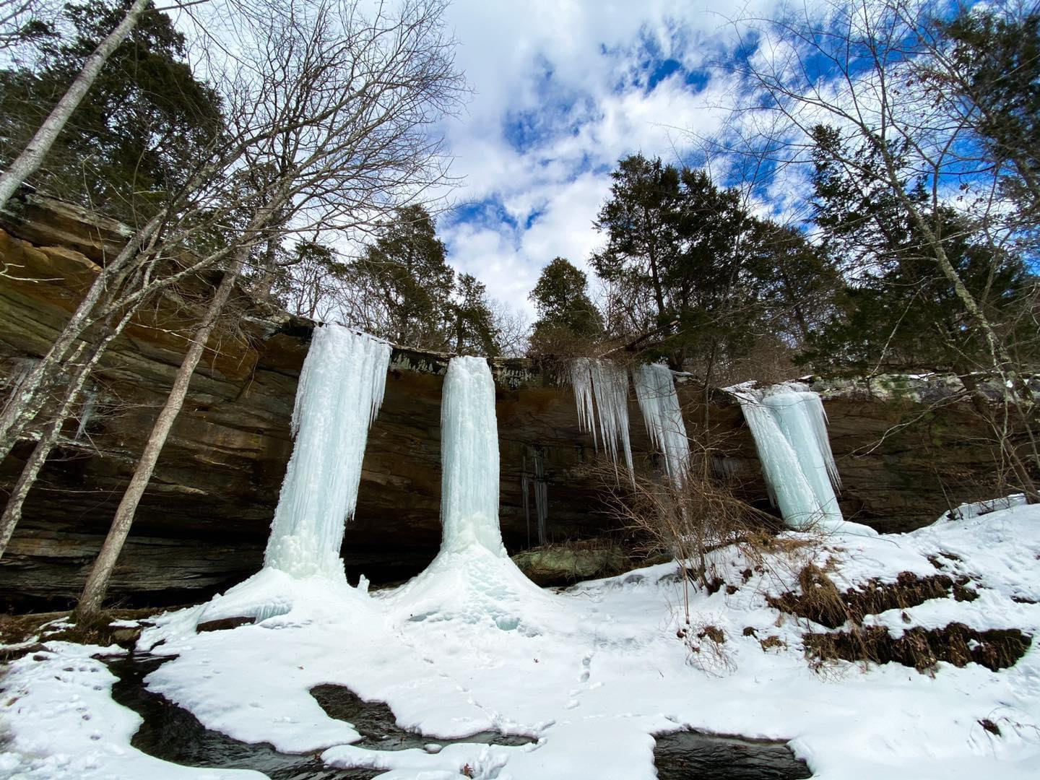
JACKSON HOLE
POPE COUNTY NEAR EDDYVILLE
ON MUSTANG LANE (ROUGH ROAD)
BE CAREFUL HIKING OVER TOP OF WATERFALL
TRAILS ARE RUGGED
BEST FROZEN WATERFALL SPOT IN MY OPINION
PLEASE PUT SAFETY FIRST
HORSE HIGHLINE AVAILABLE
TREAD LIGHTLY

Slide 19
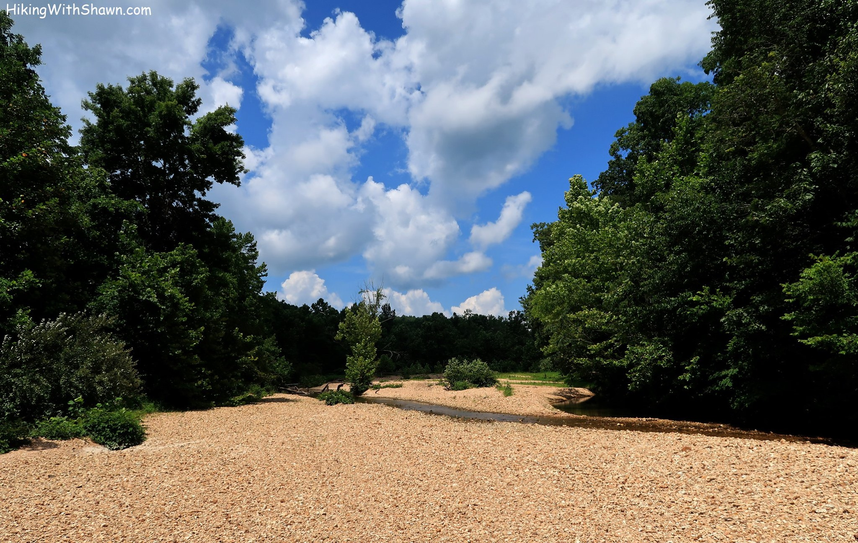
HUTCHINS CREEK
CAN BE EASILY DRIVEN TO FROM THE SOUTH
BEST AND QUIETER ACCESS IS FROM EAST GODWIN OR WEST GODWIN
WATCH OUT FOR RATTLESNAKES DURING WARMER MONTHS
GREAT PLACE TO WADE AND GET INTO THE WATER DURING A HOT DAY
RIVER TO RIVER TRAIL

Slide 20
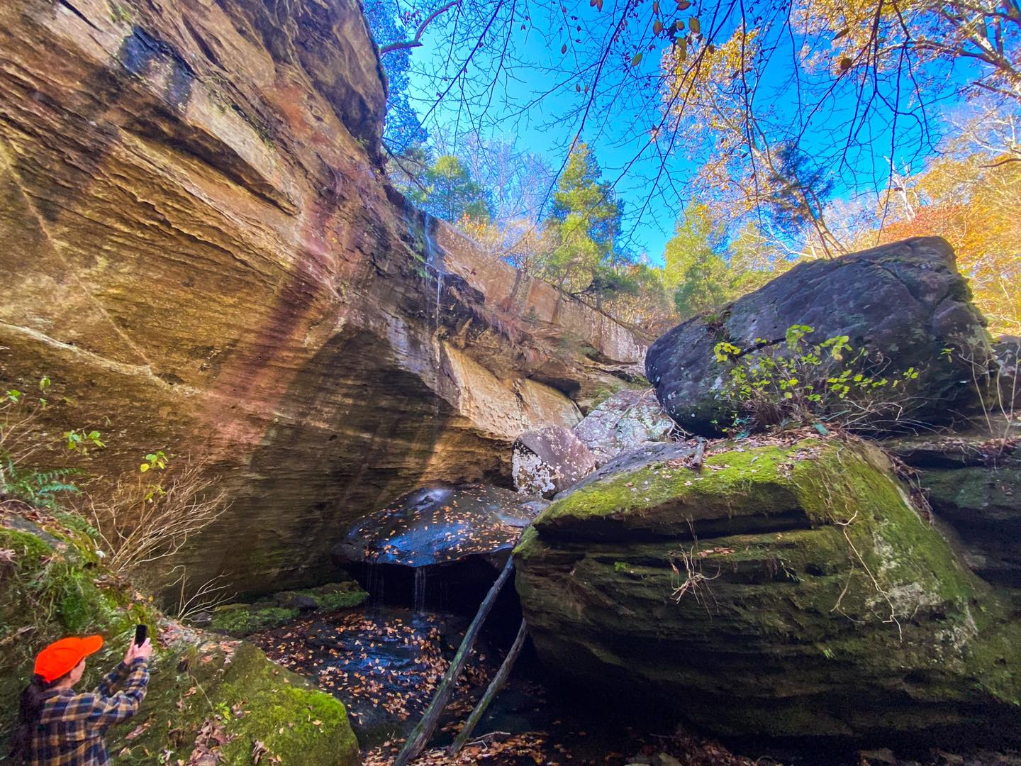
SPLATTERSTONE FALLS AND THE JACKSON HOLLOW AREA
JACKSON HOLLOW ECOLOGICAL AREA
TRAIL 001T “COVE HOLLOW” IS THE MOST SCENIC ACCESS TO THE WATERFALL
GREAT WHEN FROZEN
GREAT WHEN REALLY WET
PRETTY TRAILS THROUGHOUT THE AREA
I CALL JACKSON HOLLOW AN ENDLESS LINE OF BLUFFAGE

Slide 21
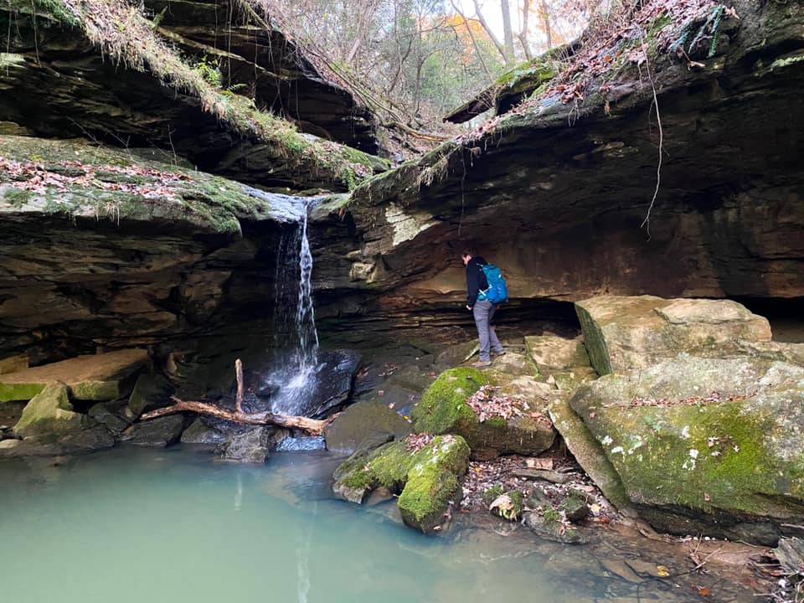
DUTCHMAN LAKE
A LOT OF WATERFALL SPOTS
FOLLOW TRAILS TO CREEKS AND HIKE UP CREEK TO SEE WATERFALLS
GREAT FOR FROZEN WATERFALLS
TRAILS ARE RUGGED AND NOT DESIGNATED, SO NOT MAINTAINED
BE SAFE WHEN VISITING

Slide 22
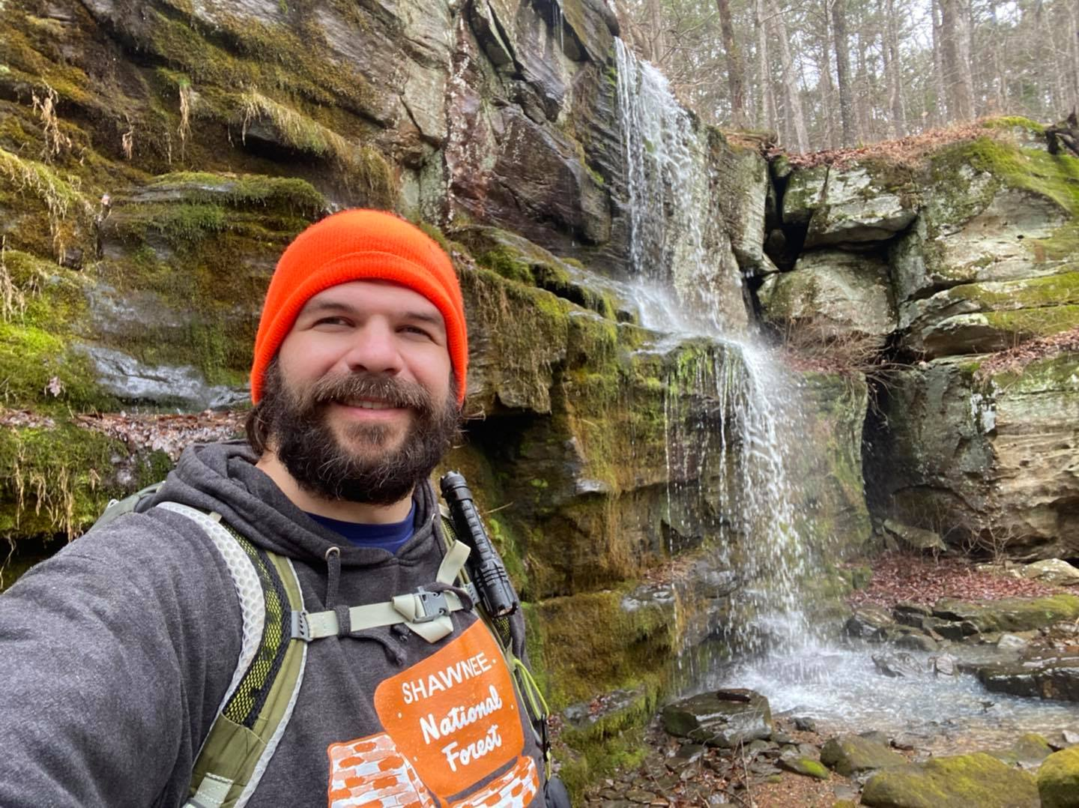
EAGLE FALLS
LOCATED ON THE WHITE TRAIL PAST THE JUMPING SPRING
TRAIL GETS RUGGED AFTER ABOUT 1 MILE
TRAIL WILL TAKE YOU ALL THE WAY TO JACKSON FALLS
EAGLET FALLS IS JUST ON THE BOTTOM OF THE CASCADE
DURING HIGHER WATER, YOU MIGHT BE ABLE TO KAYAK HERE

Slide 23
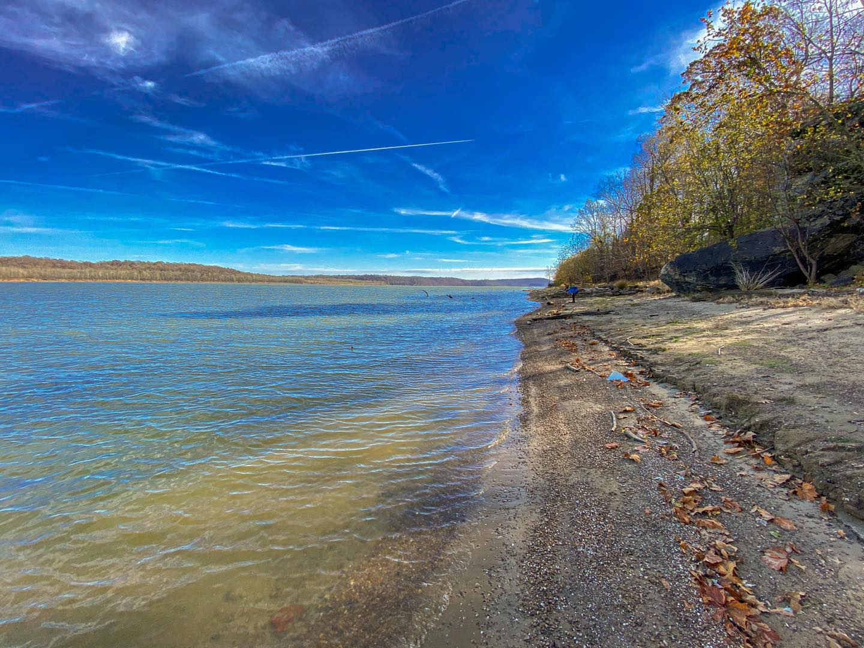
BATTERY ROCK
OLD LEG OF THE R2R TRAIL OHIO TERMINUS
AREA IS TOO REMOTE, THAT’S WHY IT WAS MOVED
CIVIL WAR SITE, WESTERN FILM LOCATION (HOW WEST WAS WON)
BEAUTIFUL BLUFFAGE WITH BEST BANDING I’VE EVER SEEN
AWESOME VIEWS OF THE OHIO RIVER
CIVIL WAR CARVINGS

Slide 24
LEAVE WITH GOOD MEMORIES, NOT BAD INJURIES
PLEASE EXERCISE SAFETY FIRST WHILE ENJOYING SOUTHERN ILLINOIS STATE PARKS AND THE SHAWNEE NATIONAL FOREST.
THERE ARE MULTIPLE FALLS AND FATALITIES EACH YEAR. STAY SAFE AND DON’T BECOME A STATISTIC IN MY NEXT SAFETY ARTICLE.
TELL SOMEONE WHERE YOU’RE GOING. BRING ENOUGH FOOD AND WATER TO LAST YOU A FEW DAYS JUST IN CASE. BE EXTREMELY CAREFUL AROUND EDGES OF CLIFFS AND STEEP AREAS.
AND REMEMBER CELL PHONE RECEPTION ISN’T ALWAYS THERE AND IT MIGHT TAKE HOURS FOR FIRST RESPONDERS TO REACH YOU.

Slide 25
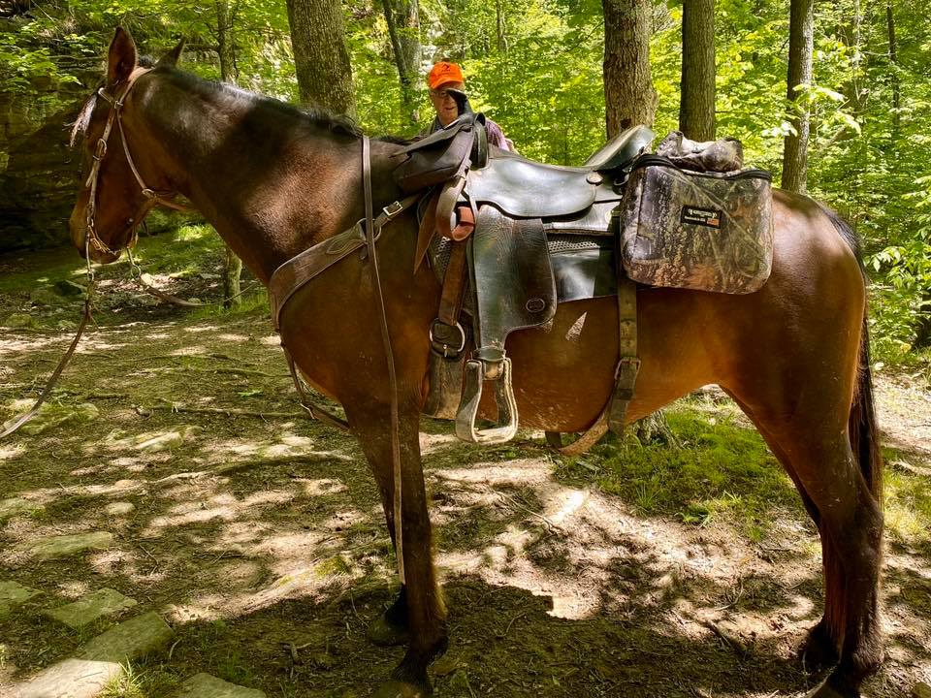
EQUESTRIAN SAFETY!
A LOT OF THE BEST PLACES IN THE SHAWNEE ARE ON HORSE TRAILS
IF YOU SEE A RIDER, ANNOUNCE YOURSELF AND YIELD TO THE RIDER
TALK TO THEM IN YOUR NORMAL VOICE AND CARRY ON A CONVERSATION
THIS LET’S THE HORSE OR MULE KNOW YOU’RE NOT A THREAT
IT’S SAFE FOR YOU, THE ANIMAL, AND THE RIDER

Slide 26
ANY QUESTIONS?

